Slide 1
Uninformed Search
(Blind Search)

Slide 2
Uninformed Search | Informed Search
Search without information | Search with information
No knowledge | Use knowledge to steps to solution
Time consuming | Quick solution
More complexity (Time, Space) | Less complexity (Time, space)
DFS, BFS | A* , Best first search

Slide 3
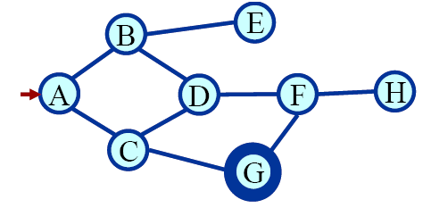
Find a Path
Shortest Path
Blind Search
  BFS
  DFS

Slide 4
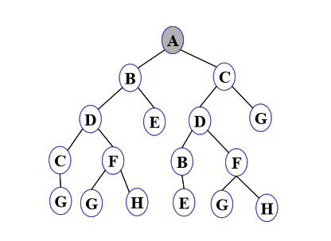
Search Tree
One may list all possible paths
Eliminating cycles from the paths
Get the complete search tree from a state space graph

Slide 5
Search Tree-Terminology
Root Node:
  The node from which the search starts.
Leaf Node:
  A node in the search tree having no children.
Ancestor/Descendant:

Slide 6
Search Tree-Terminology
Branching factor:
  The maximum number of children of a non-leaf node in the search tree
Path:
  A path in the search tree is a complete path if it begins with the start node and ends with a goal node. Otherwise it is a partial path.

Slide 7
Search Tree

Slide 8
Evaluating Search strategies
Completeness:
  Is the strategy guaranteed to find a solution if one exists?
Optimality:
  Does the solution have low cost or the minimal cost?
What is the search cost associated with the time and memory required to find a solution?
  Time complexity: Time taken (number of nodes expanded) (worst or average case) to find a solution.
  Space complexity: Space used by the algorithm measured in terms of the maximum size of fringe.

Slide 9
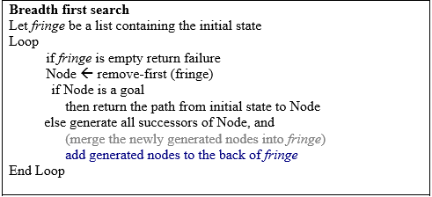
Breadth First Search

Slide 10
Breadth first search
Breadth first search the newly generated nodes are put at the back of fringe or the OPEN list.
This implies that the nodes will be expanded in a FIFO (First In First Out) order.

Slide 11
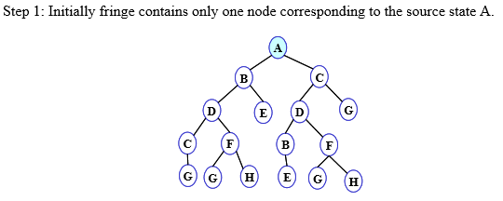

BFS illustration

Slide 12
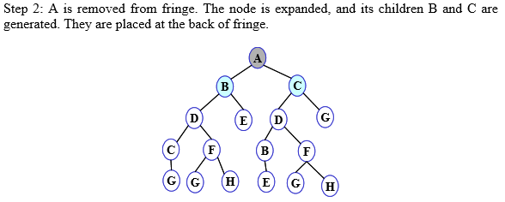

Slide 13
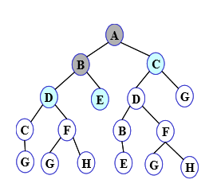

Slide 14
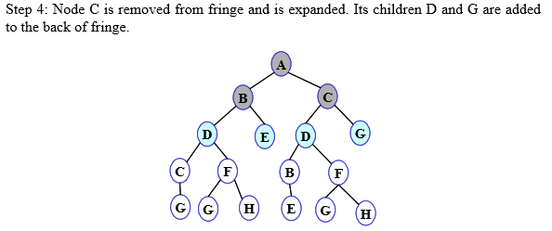


Slide 15
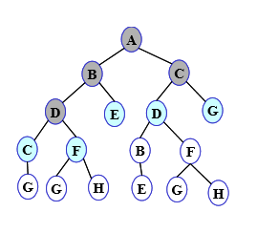

Slide 16
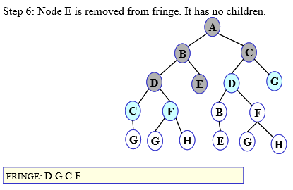

Slide 17
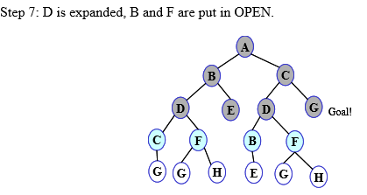


Slide 18


Slide 19
Properties of Breadth-First Search
Complete (always find the solution if one exists
The algorithm is optimal (i.e., admissible) if all operators have the same cost. Otherwise, breadth first search finds a solution with the shortest path length.
The algorithm has exponential time and space complexity. Suppose the search tree can be modeled as shown in fig. Then the time and space complexity of the algorithm is O(b^{d}) where d is the depth of the solution and b is the branching factor (i.e., number of children) at each node.

Slide 20
Advantages & Disadvantages
Advantages of Breadth First Search:
  Finds the path of minimal length to the goal.
  BFS is fast for small problems, but become slow and memory heavy for deep and large problems.
Disadvantages of Breadth First Search:
  exponential space required for the storage of a tree

Slide 21
Depth first Search
Let fringe be a list containing the initial state
Loop
if fringe is empty return failure
Node Å remove-first (fringe)
if Node is a goal
then return the path from initial state to Node else generate all successors of Node, and (merge the newly generated nodes into fringe)
add generated nodes to the front of fringe
End Loop

Slide 22
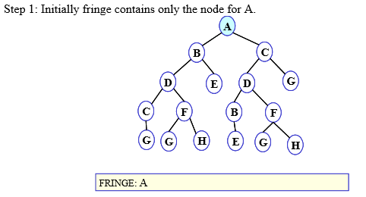
DFS illustration

Slide 23
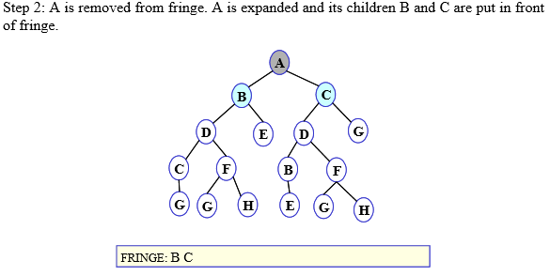

Slide 24
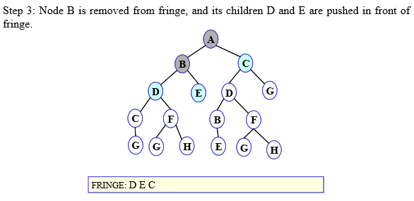

Slide 25
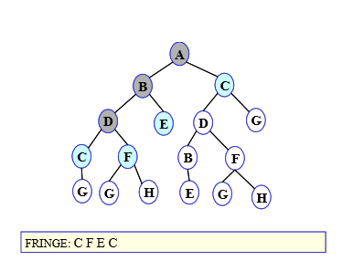

Slide 26
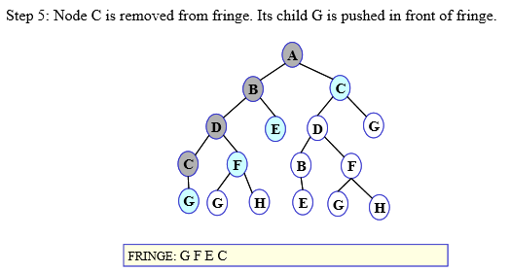

Slide 27
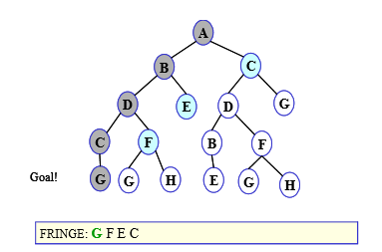

Slide 28
What is the Complexity of Depth-First Search?
Time Complexity (d is deepest path)
  assume (worst case) that there is 1 goal leaf at the RHS
  so DFS will expand all nodes
  =1 + b + b²+ ......... + b^{d}
  = O (b^{d})
Space Complexity
  how many nodes can be in the queue (worst-case)?
  at depth l < d we have b-1 nodes
  at depth d we have b nodes
  total = (d-1)*(b-1) + b = O(bd)
d=0
d=1
d=2
G
d=0
d=1
d=2
d=3
d=4

Slide 29
Properties of Depth First Search
The algorithm takes exponential time.
  If N is the maximum depth of a node in the search space, in the worst case the algorithm will take time O(b^{d}). b=branching factor, d=depth of tree
However the space taken is linear in the depth of the search tree, O(bN).

Slide 30
Properties of Depth First Search
Depth First Search is not complete
  If the search tree has infinite depth, the algorithm may not terminate. This can happen if the search space is infinite
  DFS is not optimal

Slide 31
Depth Limited Search
A variation of Depth First Search circumvents the above problem by keeping a depth bound.
Nodes are only expanded if they have depth less than the bound.
This algorithm is known as depth-limited search.

Slide 32
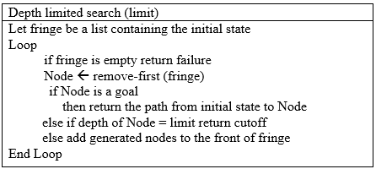
Depth Limited Search

Slide 33
Depth-First Iterative Deepening (DFID)
First do DFS to depth 0 (i.e., treat start node as having no successors), then, if no solution found, do DFS to depth 1, etc.

Slide 34

Depth-First Iterative Deepening (DFID)

Slide 35
Procedure
Successive depth-first searches are conducted
Each with depth bounds increasing by 1

Slide 36
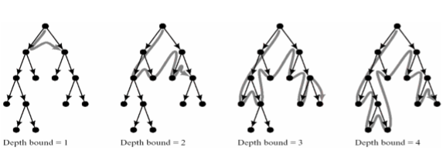
Procedure

Slide 37
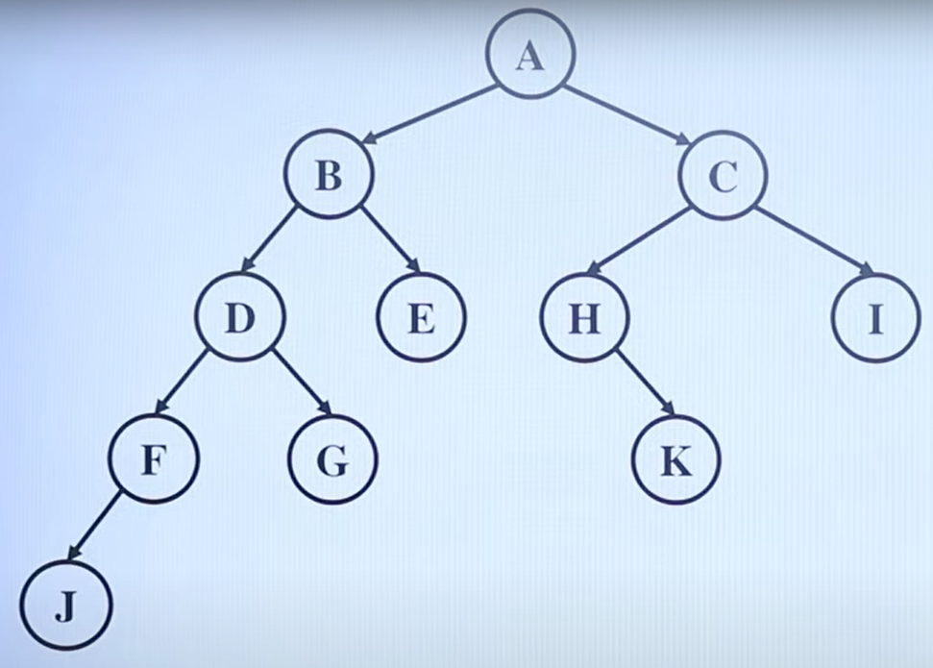

Slide 38
Key points of DLS
Depth Limitation: The primary characteristic of DLS is the depth limit.
Completeness: DLS is incomplete. If solution exists beyond the depth limit. It only guarantees finding a solution if it exists within the specified limit.
Time complexity: O(bL). B is branching factor and L is limit)
Space complexity: O(L).
Optimality: Not optimal
Application: DLS is used in a case where the search space is too large or deep search space.

Slide 39
Iterative deepening search
To avoid the infinite depth problem of DFS, we can
decide to only search until depth L, i.e. we don’t expand beyond depth L.
→ Depth-Limited Search
What of solution is deeper than L? → Increase L iteratively.
→ Iterative Deepening Search

Slide 40
Iterative deepening search
Combined the benefits of DFS and BFS.
Searches to limited depth, increasing the limit with each iteration.
Ensure both completeness and optimality.
Ensure exploration of all nodes at each depth before going deeper.

Slide 41
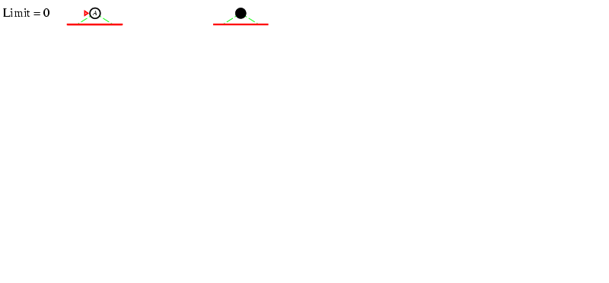
Iterative deepening search L=0

Slide 42
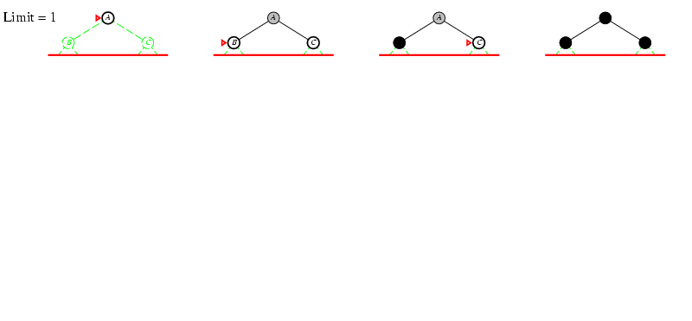
Iterative deepening search L=1

Slide 43
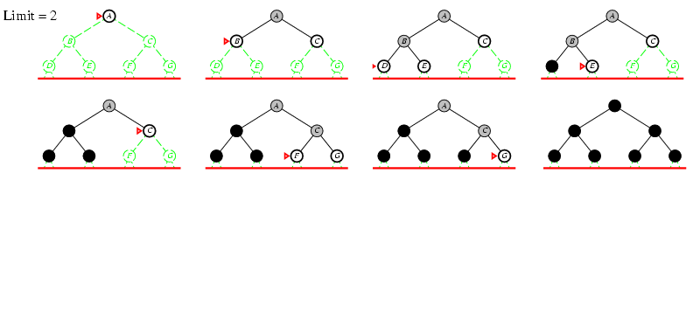
Iterative deepening search lL=2

Slide 44
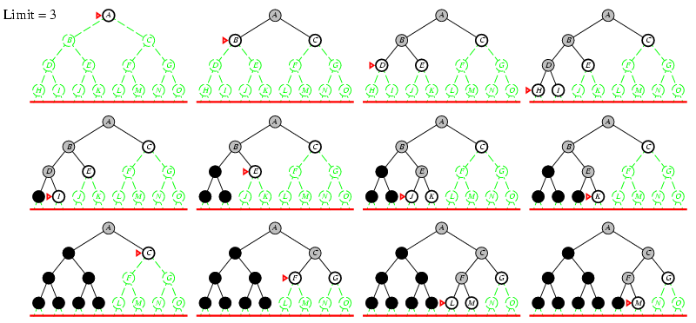
Iterative deepening search L=3

Slide 45
Properties
Complete
Optimal/Admissible if all operators have the same cost. Otherwise, not optimal but guarantees finding solution of shortest length (like BFS).
Time complexity is a little worse than BFS or DFS because nodes near the top of the search tree are generated multiple times, but because almost all of the nodes are near the bottom of a tree, the worst case time complexity is still exponential, O(b^{d})

Slide 46
Properties
If branching factor is b and solution is at depth d, then nodes at depth d are generated once, nodes at depth d-1 are generated twice, etc.
Linear space complexity, O(bd), like DFS

Slide 47
Advantages & Disadvantages
Depth First Iterative Deepening combines the advantage of BFS (i.e., completeness) with the advantages of DFS (i.e., limited space and finds longer paths more quickly)
This algorithm is generally preferred for large state spaces where the solution depth is unknown.

Slide 48
Advantages & Disadvantages
Advantage s:
  Linear memory requirements of depth-first search
  Guarantee for goal node of minimal depth

Slide 49
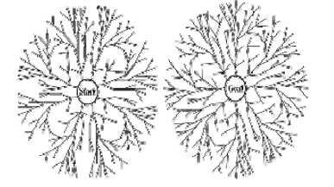
Bi-directional search

Slide 50
Bi-directional search
Algorithm:
  Bidirectional search involves alternate searching from the start state toward the goal and from the goal state toward the start.
  The algorithm stops when the frontiers intersect.
  Works well only when there are unique start and goal states.

Slide 51
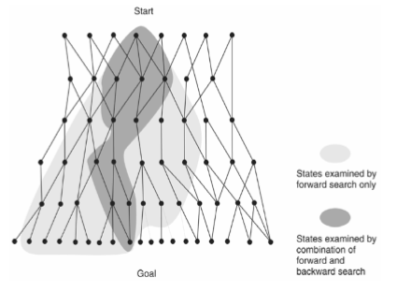
Bi-directional search

Slide 52
Time and Space Complexities
Consider a search space with branching factor b. Suppose that the goal is d steps away from the start state. Breadth first search will expand O(bd) nodes.
If we carry out bidirectional search, the frontiers may meet when both the forward and the backward search trees have depth = d/2.
Suppose we have a good hash function to check for nodes in the fringe. IN this case the time for bidirectional search will be O((b power(d/2).
Also note that for at least one of the searches the frontier has to be stored. So the space complexity is also O((bd/2).

Slide 53
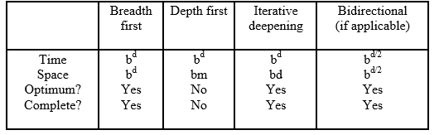
Comparing Search Strategies

